Slide 1

Introduction to Robotics
2016 Fall

Slide 2
Project Roadmap
Class | Date | Project | Finished?
1 | 9/06/16 | Introduction of Robot and Robotics, mBot Assembly | yes
2 | 9/13/16 | Introduction of mBlock | yes
3 | 9/20/16 | Play an Octave | yes
4 | 9/27/16 | Push a Button | yes
5 | 10/04/16 | Light Sensor, UltraSonic Sensor | yes
6 | 10/11/16 | Drive with Remote, Line Following | yes
7 | 10/18/16 | Robot Movement 1 | yes
8 | 10/25/16 | Robot Movement 2, Trace a Shape | yes
9 | 11/01/16 | Obstacle Avoidance | yes
10 | 11/08/16 | Sumo Wrestling 1
11 | 11/15/16 | Sumo Wrestling 1
12 | 11/22/16 | Maze
13 | 11/29/16 | Servo and Autonomous Car
14 | 12/06/16 | C Programming
15 | 12/13/16 | Robotics in the future

Slide 3
Autonomous Cars

Slide 4
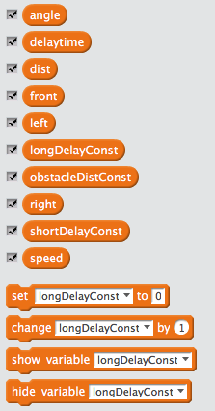
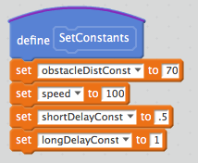
Implement: Variables and Initialization

Slide 5
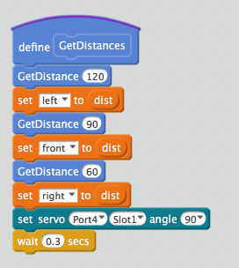
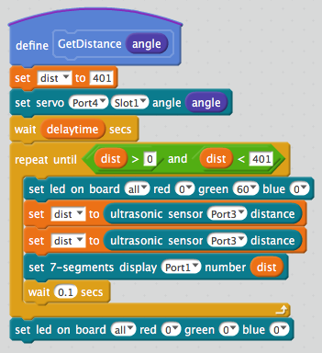
Implement: Get distances from three directions

Slide 6
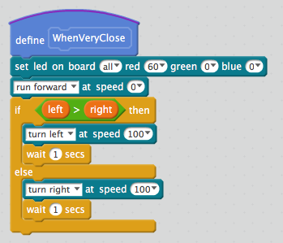
Implement: respond when very close to an obstacle

Slide 7
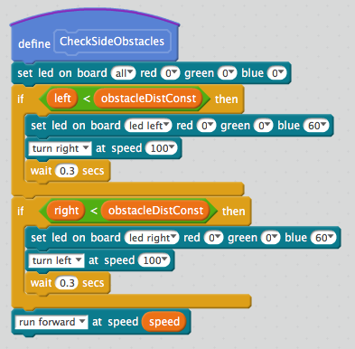
Implement: respond to side obstacles

Slide 8
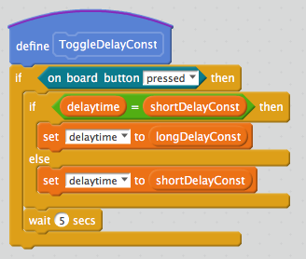
Implement: Toggle delay values

Slide 9
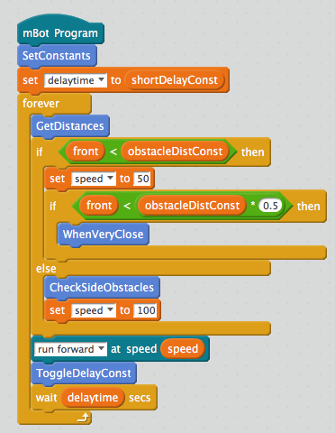
Implement: Main Program Logic

Slide 10
Challenges

